Slide 1
Computer-aided assessment
– embedding CAA in an effective way
Martin Greenhow
Mathematical Sciences
Brunel University

Slide 2
A dilemma
Students do things only for marks (from school?)
They work to the next test only (even missing lectures!)
So individual lecturers need to set plenty of assessments in order to get their share of students’ attention/engagement (else they fail the module)
So students have no time for reflection and understanding
Go to 1) above!
Result: the course is no fun!

Slide 3
CAA at Brunel University
Javascript, MathML, SVG, web delivery
Questions database spans GCSE, A-level, undergraduate topics
>3500 questions in the database each generating thousands of millions of realisations for student use
Hundreds of users take circa 30,000 tests p.a. Students from Maths, Economics, Electrical and Electronic Engineering, Computing, Foundations of Engineering, Foundations of IT, PGCE and Sports Science, even MSc student diagnostics. No Management (yet!) so the rest follows from economics use

Slide 4
CAA in practice
Low-stakes summative assessment - invigilated or not.
Preferred scheme: best-ever mark from their first 5 attempts counts towards their module mark; not invigilated and group work is allowed/encouraged. Exam pass required!
Blended assessment (CAA, traditional exams, labs, reports & essays …)
Mostly we aim to promote learning … we don’t really need more marks!

Slide 5
Mathematics for Economics (year-by-year changes in assessment)
2006-07, 2007-08: no CAA; A and non-A cohorts – results indistinguishable; two class tests, one 3-hour exam set by economics staff (10 days - times 2?)
2008-09: CAA introduced; 3-hour exam only (2 days - times 2?)
2009-10, 2010-18: one cohort, admission AS level mathematics; exam pass mandatory; 2-hour exam only (set by MG to 2015)
(3 days!!!!!!)

Slide 6
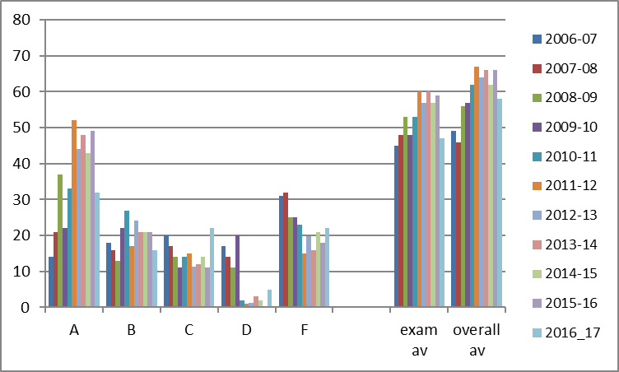
Maths for Economics year-on-year results (% in grade/% mark) circa 400,000 questions done
CAA started

Slide 7
Metal HEA Project
Used design methodology and experiences to set objective maths for economics
Questions – not tests; staff can pick & mix
Backed up by videos, case studies & simulations; questions sometimes link to these
Has since been extended considerably – often by Final Year Project students doing Financial Maths
Classified by topic and tagged for Search Engine
Main feature: FULL FEEDBACK which students study (a lot)

Slide 8
Topics in Economics

Slide 9
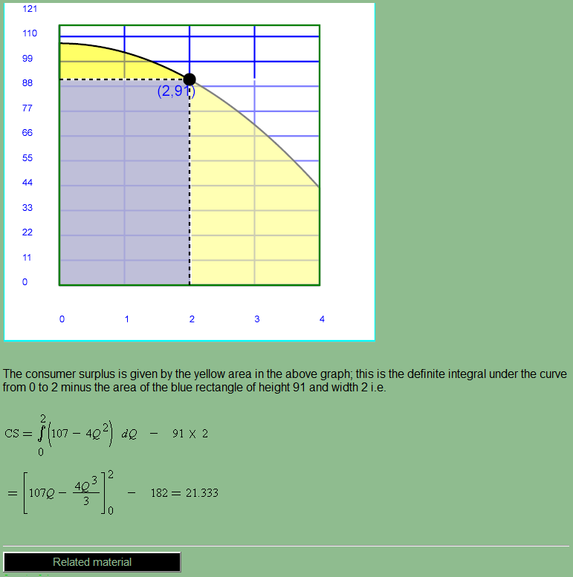
Feedback - contextualised
economics question
part of the formative feedback
SVG diagram realised according to the random parameters in the question
related material button links to any web resource (via centrally-held lookup array)

Slide 10
Feedback

Slide 11
DeSTRESS JISC Project
Builds on the Metal question design methodology and experiences to test basic stats for social sciences
Released new material end August 2011
Hand calculation with realistically-sized data sets – solution to link with external software such as Excel, SPSS
Real data? Data cannot be ‘designed’ to have certain features or not. Problems with keeping the data and answers current without accessing live web sites (problems of access and communication with the marking scheme).
Another challenging area is the interpretation of charts and graphs

Slide 12
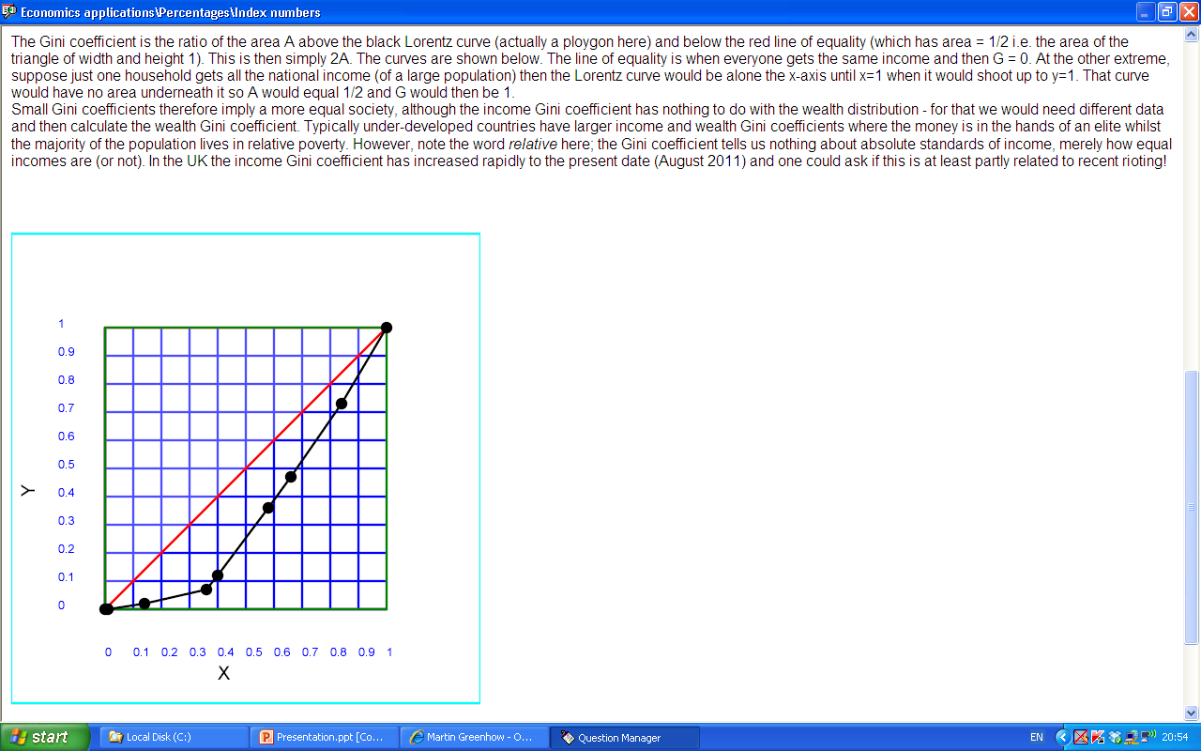
Gini coefficient
G = A/(A+B) = 2A
A
B

Slide 13
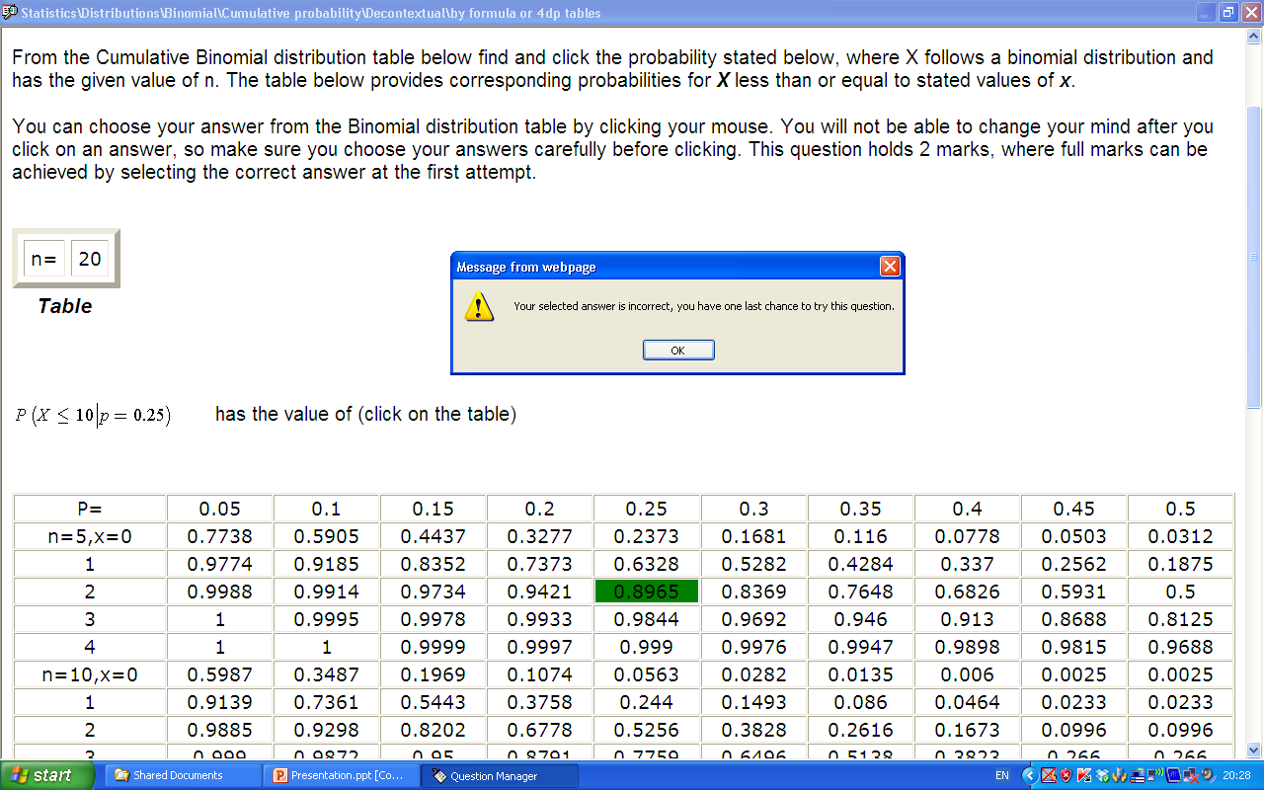
A statistics question - tables or formula?

Slide 14
Javascript, MathML and SVG provide a rich environment for setting objective questions
Positive effects on students’ perceptions and on exam performances
Widely applicable database of questions
Good source of reverse-engineered questions for all, especially teachers
Maths e.g. Try it at:
http://www.mathcentre.ac.uk:8081/mathseg/
http://www.mathcentre.ac.uk:8081/mathsegteacher/
works on all browsers, PC & Mac, I-pads and smart phones, no link to VLEs yet!

Slide 15
And now for something completely different …
– Study Skills Online at:
http://people.brunel.ac.uk/~mastmmg/ssguide/sshome.htm

Slide 16
Accessibility & languages
Topics
Popular & highly-rated by Google
Student tasks
A spoof!
But the rest is real!
Designed for STEM students but covers much on common with all students

