Slide 1

External Examiners’ Induction
Presented By: Mandhir Gill
Head of Quality Assurance

Slide 2
Aims for the Session
To introduce recently appointed External Examiners to:
The University
Brunel Programmes
Changes to credit structure
Assessment and External Examining at Brunel
Panels and Boards of Examiners at Brunel
Brunel Academic Regulations
The Annual Reporting Process
Please put any questions in the chat function, and we will try to answer them in the end.

Slide 3
Brunel University of London
Awarded its Royal Charter in 1966 transforming it from Brunel College to Brunel University, later becoming Brunel University London.
Brunel is located in Uxbridge having previously operated across four campuses.
University’s history can be traced back to 1798 through our predecessor colleges.
Joined the University of London Federation on 1st October 2024, now called Brunel University of London

Slide 4
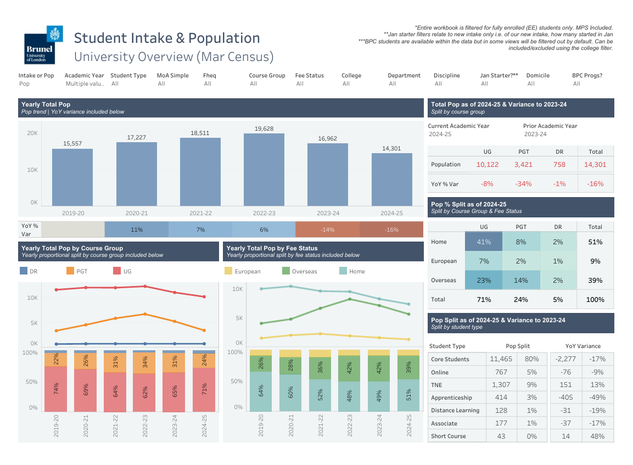
Brunel’s Student Population

Slide 5
Brunel 2030
The University’s Strategy identifies five distinct areas of focus:
World leading Technical University
Powered by Diversity
London campus with unparallel global reach
Driven by Social Mission
Co-creating with business and industry
More information on the University’s strategy can be found here.

Slide 6
University Structure
The University is led by its Vice-Chancellor and President, Professor Andrew Jones, who is supported by:
Pro Vice Chancellor Education – Professor Claire Turner
Pro Vice Chancellor Research – Professor Hua Zhao
Pro Vice Chancellor Enterprise and Employment– Professor Geoff Rodgers
Pro Vice Chancellor International and Sustainability – Professor Trevor Hoey
Information on the University’s Vice-Chancellor and other senior officers is available here.

Slide 7
Colleges
The University’s educational provision is delivered through four Colleges:
CALSS - College of Arts, Law and Social Sciences
BBS- Brunel Business School
CEDPS - College of Engineering, Design and Physical Sciences
CHMLS - College of Health, Medicine and Life Sciences
Divided into Departments.
Supported by the Central Administrative Team.

Slide 8
College of Arts, Law and Social Sciences (CALSS)
Executive Dean - Professor Joshua Castellino
Departments:
Education
Arts and Humanities (English and Creative Writing, Theatre, Music, Film and TV, Games Design)
Social and Political Sciences (Politics & History, Journalism, Anthropology, Sociology, Media and Communications, Global Challenges)
Brunel Law School

Slide 9
Brunel Business School (BBS)
Executive Dean - Professor Danae Manika
Departments:
Department of Economics, Finance and Accounting
Department of Business Analytics and Marketing
Department of Strategy, Entrepreneurship and Management

Slide 10
College of Engineering, Design and Physical Sciences (CEDPS)
Executive Dean – Professor Abdulnaser Sayma
Departments:
Brunel Design School
Chemical Engineering
Civil and Environmental Engineering
Computer Science
Electronic and Electrical Engineering
Environmental Sciences
Mathematics
Mechanical and Aerospace Engineering

Slide 11
College of Health, Medicine and Life Sciences (CHMLS)
Executive Dean – Dr Terry Dovey (Interim), Professor Patrick Leman (from 1st Aug 2025)
Departments:
Health Sciences (Occupational Therapy, Physiotherapy, Physician Associate, Nursing, Global Public Health, Social Work)
Biosciences
Psychology
Sport, Health and Exercise Sciences
Brunel Medical School

Slide 12
Brunel Pathway College (BPC)
Recruitment and progression to Brunel is supported by Brunel University of London Pathway College, which delivers the following programmes:
Foundation programmes – students progress to year 1/FHEQ level 4 of an undergraduate degree
Alternative Level 4 programmes – students progress to year 2/FHEQ level 5 of an undergraduate degree
Pre-masters programmes – students progress to a masters at Brunel.
BPC students are Brunel students from day one.

Slide 13
Research
The University’s research activity is organised through the following institutes:
Institute of Communities and Society
Institute of Digital Futures
Institute of Energy Futures
Institute of Health, Medicine and Environments
Institute of Materials and Manufacturing
Research centres are groups within the University’s Colleges.

Slide 14
Academic Leadership within Colleges
Within each College, the following staff lead on academic matters:
Deputy Dean
Vice Dean (Education)
Vice Dean (Research)
Associate Dean (Equality, Diversity and Inclusion)

Slide 15
Academic and Student Administration
Curriculum and Awarding
Business Support (Data Management, Records and Funding).
Quality Assurance.

Slide 16
Senate Regulations
The University’s academic provision is governed by its Senate Regulations - all published at: https://www.brunel.ac.uk/about/administration/senate- regulations.
Senate Regulation 2: Undergraduate programmes/awards (FHEQ Levels 4, 5 and 6, and Integrated Masters)
Senate Regulation 3: Postgraduate Taught programmes/awards (FHEQ Level 7)
Senate Regulation 4: Assessment, Extenuating Circumstances
Panel and Board of Examiners Protocol

Slide 17
Policies and other Key Documents
The University’s External Examiners for Taught Programmes Policy.
Policies regarding assessment are available externally at https://www.brunel.ac.uk/about/quality- assurance/assessment.
Panel and Board of Examiners Protocol
EEs also have access to the University’s programme specification and block/module outline repository here - Programme Documentation Repository (brunel.ac.uk).
Brunel University London

Slide 18
Key Contacts for External Examiners
As an External Examiner your key contacts at the University will be:
Programme leader/s for the award/awards you are responsible for
Central Administrative Team
External@brunel.ac.uk (appointment, reporting, payment, general queries)

Slide 19
Brunel Programmes

Slide 20
Brunel Programmes
Brunel offers the following taught programmes/award types:
Honours Bachelors Degrees (BA, BSc, etc.)
Foundation Degrees (FdSc, FDA)
Certificates and Diplomas of Higher Education
Masters Degrees (MA, MSc, MRes)
Postgraduate Certificates and Diplomas
Programme structure generally conforms to sector norms (total credits, credits per year).
Vast majority of UG programmes have a placement year option
Programme structure, progression and awarding rules are governed by Senate Regulations.
Variations to Senate Regulations are presented in programme specifications (PSRB requirements).

Slide 21
Programme Structure
Brunel programmes are made up of “blocks”.
Modular blocks = modules.
Brunel programmes can also be structured though a combination of “Study Blocks” and “Assessment Blocks”:
Study Blocks = capture the learning that is to take place
Assessment Blocks = capture the assessment that is to be undertaken and the learning outcomes to be demonstrated
Higher education credit is awarded against successful completion of modular or assessment blocks.

Slide 22
Programme Structure Continued
Brunel blocks are either:
Compulsory – the student is required to take it.
Optional – the student may choose it from a list of blocks (but must still achieve a total number of credits)
The University allows students to progress and be awarded with a limited amount of E grades at UG, and D grades at PGT, unless it is designated ‘Core’. There are 3 types of ‘Core’:
Core Block – the block must be achieved at D- or above (UG) or C- or above (PGT)
Core Element – the specified element of assessment must be achieved at D- or above (UG) or C- or above (PGT), but the overall block result could still be in the E band (UG) or D band (PGT)
Core All – all elements of assessment must be achieved at D- or above (UG) or C- or above (PGT), and therefore the block overall is core too.

Slide 23
Assessment and External Examining

Slide 24
Assessment of Students
Brunel academic teams assess either through marks or grades.
All modular and assessment blocks result in a grade.
A generic set of undergraduate and postgraduate grade descriptors are maintained and available at https://www.brunel.ac.uk/about/quality- assurance/assessment.

Slide 25
Internal Moderation
“Internal moderation supplements external moderation by External Examiners, and is undertaken to ensure that sound and consistent academic judgements are made during the marking process.”
Brunel operates a Policy for Internal (Strategic) Moderation and Double Marking:
Risk-based approach (marking by GTA or HPLs, or an inexperienced module leader; persistent over or under performance of students; EE concerns; or student feedback)
Does not preclude Divisions / Departments from undertaking moderation that is more extensive
NB. PGT Dissertations and UG final year dissertations are always double marked

Slide 26
External Moderation/Examining
External Examiner role is at programme level.
Each award must have at least one examiner.
Examiners may be appointed to multiple awards.
Awards may have multiple Examiners – block distribution is determined by programme team.
Examiners can request to speak to students

Slide 27
External Moderation/Examining Continued
Responsibilities include:
External scrutiny of assessment tasks (prior to release)
External moderation of summative assessments
Oversight/Feedback before the Panel of Examiners deadline
Attendance at the Board of Examiners
Other meetings with staff and/or students as agreed (e.g. placement visits, project presentations)
Production of an annual report (more on that later)

Slide 28
External Moderation/Examining Continued
The role of the External Examiner(s) is to provide informative comment and recommendations on whether:
The University is maintaining the threshold academic standards set for its awards in accordance with the frameworks for higher education qualifications, applicable subject benchmark statements and relevant professional and statutory bodies
The assessment process measures student achievement rigorously and fairly against the intended outcomes of the programme(s) and is conducted in line with the institution’s policies and regulations
The academic standards and the achievements of our students are comparable with those in other UK higher education institutions of which the external examiner has experience.

Slide 29
External Moderation/Examining Continued
Assessment samples :
The total number of sample pieces of assessed work sent to an External Examiner in each academic year should not exceed 320 individual pieces
The External Examiner(s) should review no less than 20% of the postgraduate taught dissertations or undergraduate final year project reports, unless the cohort size is 10 or fewer, in which case all assessments should be made available.
NB. External Examiners are not required to study each piece of work in detail, but are required to satisfy themselves in regard to standards, comparability and adherence to marking processes

Slide 30
External Moderation/Examining Continued
Arrangements for external moderation of student work by the External Examiner will be made by the programme team.
Samples of assessments will be:
available electronically or sent by hard copy and/or
available for scrutiny at Brunel
Assessment samples will include records of moderation.
External Examiners have access to all assessed material.

Slide 31
Guidelines for Conducting External Moderation of Assessment Tasks
When reviewing assessment tasks, please consider the following:
Appropriateness of the assessment in the context of the learning outcomes and FHEQ level
Appropriateness of the assessment in the context of the academic discipline and associated careers
Clarity of instruction/quality of communication to students
Appropriateness of case studies, examples etc.
Appropriateness of the grading/marking scheme

Slide 32
Guidelines for Conducting External Moderation of Student Work
When reviewing student work, please consider the following:
The standards demonstrated by students and their performance in relation to their peers on comparable programmes at other institutions.
Quality of the assessment process: marking; internal moderation including consistency of practice; double marking (where applicable).
Quality of feedback, for example:
Is it consistent with the mark/grade given?
Is it of sufficient quantity?
Does it clearly identify strengths but also highlight areas for improvement?
Are feedback practices consistent across blocks?

Slide 33
External Benchmarks for External Examining
Framework for Higher Education Qualifications.
Subject Benchmark Statements.
PSRB requirements (where applicable).
Quality Code for Higher Education, in particular the Advice and Guidance for Assessment.
Office for Students Regulatory Framework, in particular the B conditions for Quality and Standards.

Slide 34
Panels & Boards of Examiners

Slide 35
Panels of Examiners
Where collective academic judgement is employed.
Key role: to verify and confirm the marks/grades for each module/block.
Do not look at individual students (unless error or additional information is presented).
May make specific recommendations to Boards concerning particular assessments.
Based on anonymised paperwork.
Conducted as a remote desk-based exercise

Slide 36
Panels of Examiners Continued
The role of an External Examiner at a Panel of Examiners is to:
Contribute to Panel decision-making as required
To ensure that Panels operate:
Fairly
Consistently
In line with the University’s regulations
In the interest of students
To advise on the need or appropriateness of measures such as the reconsideration of grades or scaling.
External Examiners should query/ask for clarification where needed.

Slide 37
Panels of Examiners Continued
If the Panel is not satisfied with the fairness or integrity of assessments/marking, it should not confirm grades/marks.
Appropriate action is normally for assessors to reconsider grade/marks for an entire block.
Rounding by Panels is not permitted.
Only in very exceptional circumstances may the Panel scale grades/marks for a particular assessment; if so it must record the justification.
Grades/marks may not be adjusted for individual students (unless wrongly recorded or additional information is presented).

Slide 38
Boards of Examiners
Boards of Examiners are constituted in accordance with Panel and Board of Examiners Protocol.
Whilst Panels are responsible for agreeing marks/grades, Boards are responsible for agreeing awards, progression and re-assessment.
Paperwork will be presented to the Board with (anonymised) student profiles.
Programme Lead confirms appropriate processes have been followed
Decisions will be made regarding students with accepted extenuating circumstances.

Slide 39
Boards of Examiners Continued
The role of an external examiner at a Board of Examiners is to:
Contribute to Board discussion and decision making as required
To observe process and help ensure that Boards operate:
Fairly
Consistently
In line with the University’s regulations
In the interest of students
External Examiners should query/ask for clarification where needed.

Slide 40
Boards of Examiners Continued
Boards of Examiners typically take place in June and September (undergraduate) and June and November (postgraduate).
External Examiners will be invited to a Board by the department/division.
If no External Examiner is present, annotated and signed Board paperwork will be sent to the EE to consider and agree.
Brunel University London

Slide 41
Boards of Examiners Continued
To support Boards, the following safeguards are in place:
Board of Examiners chairs and support staff are provided with annual training by Quality Assurance, and are supported through advice and guidance documents.
All Boards of Examiners have a direct link to the University’s Quality Assurance Team, who can advise on complex cases.
The Chair of the Board is independent of the delivery of the programmes.
Final Board paperwork is reviewed centrally to ensure that awards (including intermediate awards) and fail/withdraw decisions are correct.

Slide 42
Brunel Regulations – Key Points for Boards/Awarding

Slide 43
Brunel Regulations
External examiners are not expected to memorise our academic regulations.
The following information is provided to:
Assist EEs in understanding Board process and decision making
Ensure that Boards conform to University regulations
The University has implemented a new 15/30 credit structure for its programmes from 2024/25.
The changes started with Levels 3 & 4 in September 2024

Slide 44
Progression of Students
Undergraduate degrees
The progression requirements for each level is as follows:
No credit at grade F
No more than 40 credits in Grade Band E (E+, E, E-) old regs
No more than 30 credits in Grade Band E (E+,E, E-) new regs
No core blocks or core assessments within a block, below D-
Postgraduate Programmes
No progression requirements as they are one level, but some part- time programmes might stipulate certain achievement at the end of a year.
Brunel University London

Slide 45
Progression of Students
Students who do not meet progression requirements are either:
Offered reassessment prior to the commencement of the next academic year
Exceptionally – provisionally progressed with reassessment undertaken in term 1
Withdrawn
Brunel University London

Slide 46
Undergraduate Award Criteria (‘E’ grade is no longer a limiter to Degree classification in new Senate Regulations 2024)
Awarding of Students
Brunel University London

Slide 47
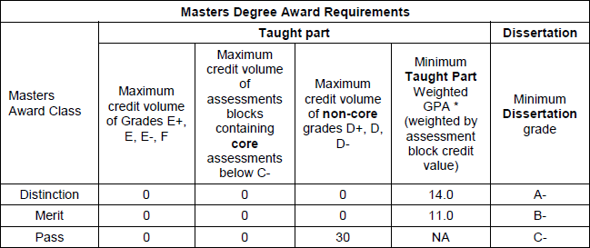
Awarding of Students
Postgraduate Award Criteria
Brunel University London

Slide 48
Reassessment of Students
Students are permitted reassessment in each block, to a maximum credit allowance.
Level | Reassessment Allowance (existing students L5/6) | Reassessment Allowance (students entering in 2024)
FHEQ L4 | Full 120 credits if required | Full 120 credits If required
FHEQ Level 5, 6 and 7 (integrated masters) | 40 credits | Full 120 credits if required (60 credits allowance in summer)
FHEQ Level 7 (Masters) | 60 credits of the taught modules + the dissertation. | 60 credits of the taught modules + the dissertation.
Students may exceed the reassessment allowance if they have accepted extenuating circumstances.
Brunel University London

Slide 49
Extenuating Circumstances
Boards of Examiners have the following options when dealing with accepted extenuating circumstances:
Re-assessment (at the same attempt)
Waive an affected assessment
Note affected assessment and consider at award board
Exceptionally, assign a grade to an affected assessment
Exceptionally, consider an aegrotat award
If the above resolutions are not appropriate, the Board may (exceptionally), present a recommendation to the Chair of the University Education and Student Experience Committee.

Slide 50
Annual Reports

Slide 51
Annual Report - Timescales
Requested in late June by the Quality Assurance Team (external) and should be completed following Boards of Examiners.
Reports should be submitted by the end of July.
Completed and submitted online via the University’s Intranet.

Slide 52
Annual Report – Focus of Report
Annual Report asks External Examiners to comment on:
Academic standards and comparability with other HEIs
Assessment processes
Standards demonstrated by students and comparability with other HEIs
Good practice, concerns and areas of enhancement
Issues that should be considered centrally (Head of QA; Vice-Chancellor).

Slide 53
Annual Report – Guidance
Report is at programme/award level, and should provide an overview/overall assessment.
Exception – Q2.2 asks for detailed observations regarding individual modules, modular blocks or assessment blocks.
If detailed block or Panel reports are provided to the programme team, please do not replicate all of the detail in the annual report, just the main comments/headlines.
Reports are published and available to all students, therefore please:
Do not include student numbers
avoid referring to or explaining individual cases or students
avoid inadvertently identifying students

Slide 54
Annual Report – Guidance
Please provide appropriately detailed comments – avoid
“no issues”.
If items are more easily discussed through a conversation with the programme team rather than the report, please consider that approach.
Please act as a critical friend in the ongoing development and enhancement of a programme.

Slide 55
Annual Report – Submitting the Report
External Examiner reports are submitted via an online portal: https://brunel365.sharepoint.com/sites/ExternalExaminers
Fields marked with an asterisk are mandatory and the form will not submit if they are empty.
You can save your report and return to it later, we recommend saving on a regular basis to avoid losing work.
We may return a report if more information is required or if a statement is unclear.
external@brunel.ac.uk

Slide 56
Scrutiny of External Examiner Reports
External Examiner Reports are reviewed by the following staff before a formal response is published:
Programme lead
Vice Dean-Education
Quality Assurance Manager for the College
Head of Quality Assurance
Pro Vice-Chancellor Education if appropriate

Slide 57
Accessing University Systems
To access the University intranet, you will need your account login (sent on appointment).
If you need to reset your password at any time, please visit https://pwreset.brunel.ac.uk and enter ACADEMIC\USERNAME or ADMINISTRATION\USERNAME in the box. A code will then be sent to your personal email.
If you have any problems with passwords or general access please contact external@brunel.ac.uk.
Please contact the academic department regarding WISEflow queries.

Slide 58

Further support resources
Guidance and resources about all aspects of these processes are available at
www.brunel.ac.uk/about/quality-assurance/external-examiners and
www.brunel.ac.uk/about/quality-assurance/assessment
Senate Regulations are published at www.brunel.ac.uk/about/administration/senate-regulations
Programme specifications and module outlines are available at Programme Documentation Repository (brunel.ac.uk).

Slide 59


Thank you

Slide 60
Questions
Brunel University London

