Slide 1
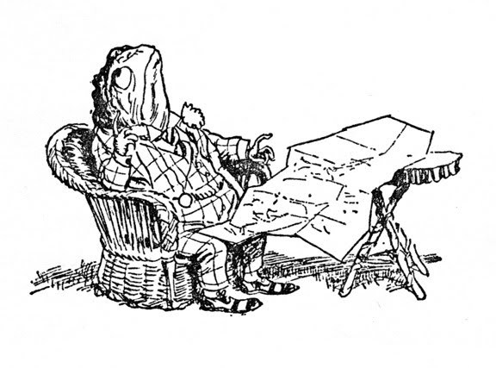
Introduction

Slide 2
Q 1/3
How do mobile devices differ from desktop?
Heterogeneous; Small screen; Interaction; Power;
Intermittent; Location aware; sensors; operated on the move
Components
Operators, Networks, Devices, Operating Systems
Application Frameworks: open v proprietarty
Web apps v native apps
What is the difference?
Why as a developer would you choose one or the other? See Lecture 1
Markup, Presentation & Actions
html5 CSS Javascript
External v Internal files. Differences. Advantages/Disadvantages. Performance implications
Q 1/3
Q 1/2
2

Slide 3
Document Object Model
What is it? Why is it used? Graphical representation
Child, parent, sibling, node. Programmatic access to the web page
How do you use the DOM to modify the contents of a web page using Javascript or jQuery
What is walking the tree? Breadth first and depth first
h2 {font-size:16px; font-family:verdana;}
property:value pairs. Use in CSS and jQuery
Q ½ to 1
selector
value
property
3

Slide 4
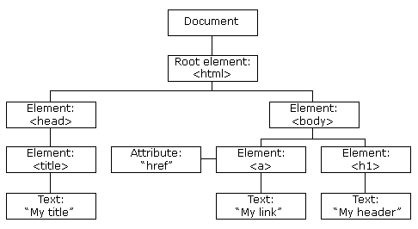
root
nodes
4

Slide 5
Design
Write use cases … stories about user interactions
Break the stories down into a set of features; and the paths between them.
Look at feature set and extract commonalities.
Decide on a implementation schedule for features
Javascript - files. “minified” for rapid downline
CDNs – what are they and why are they usefull
Q 1/4
5

Slide 6
Responsive web sites
What is meant by a responsive web site?
Why are they needed?
How do we implement them?
Screen size
Resizes the content to size (not be introducing scroll)
CSS viewport tags
Media- queries when resizing is not sufficient
Fluid layout
Resizes the viewport to screen size
Fonts
Size fixed relative to layout – not absolutely
Images
Size fixed relative to layout – not absolutely
Flexible Images
Optimise for screen size - and bandwidth
Use em – why and what is it.
Q 1/4
Q ½ to 1
6

Slide 7
Responsive web sites
Normalize or reset the style sheet – why and how.
Media queries
Format and use from the assignment
Images
Can be loaded at one size and displayed at many.
Wastes bandwidth – poor response – may not look good.
Alternate images for different sizes
Q 1/4
Q 1/4
7

Slide 8
Local storage
Cookies < 4kb. Exchanged server and client
W3C recommends 5Mb of storage space / web site.
A server can only access the space which has been allocated to its web pages.
Useful for offline operation.
Should check if local storage is supported
Storage is the form of a (key, value) pair.
Only strings stored
JSON – communication to server – building and interpreting
Code needs to be conceptually correct. Trivial syntactic errors are not important.
Q 1/3
More if asked to write code to store or retrieve data
8

Slide 9
Feature detection
Web pages should not fail – they should detect any problem. Inform user and back out gracefully
Browser based – keep a list of browsers/OS/versions with all the features supported
User agent string $_SERVER[‘HTTP_USER_AGENT’]
Check if any features you want are supported.
Library of calls for instance Modenizr – cross platform
What sort of things can you check
local storage; geolocation; …..
Advantages and disadvantages
Q 1/3
9

Slide 10
Techniques
What is a call back? How is it used?
What is an Error Handler? How is it used?
jQuery
Javascript library – simplified manipulation of the DOM.
Eases asynchronous updating of the page.
Cross browser – allows author to concentrate on content. (no need to worry about OS/browser)
Uses CSS selectors to access nodes in the DOM
Added functionality – in addition to loaded() state for the page there is ready() state.
Potentially faster response of the page
Ease the create and handling of Events
Events what are they and how are the used.
Q 1/4
Q 1/4
Q 1/4
10

Slide 11
jQuery
Objects …
content creation “on the fly”
Modification page appearance in response to events
Navigation via selectors
jQuery plugins
What are they – were are they used?
jQuery UI
What and why?
11

Slide 12
Unobtrusive java
What is it?
Usability
Graceful Degradation
Accessibility
Separation
What are they and how are they achieved?
Separation of content, behaviour and appearance
Weak coupling – high cohesion
Name space and name collisions
Q < 1
These are general coding development rules. Can be asked about together or along with other topics
12

Slide 13
jQuery mobile
Data-roles – what are they and what are their uses?
13

Slide 14
The side notes are my comments about what things are suitable for a question.
Questions will normally ask about a concept.
Clear description will be a pass
Demonstration that you are aware of the importance and can access advantages and disadvantages takes it to an A.
Integrating into a context
“What is unobtrusive java and why is it important”
I will not consider it necessary to describe in detail what I expect.
What are the principles of unobtrusive java? Describe what each one means? Explain how each of these principles help to ensure that the pages are usable, respond rapidly to user input and and that the site is easy to maintain and upgrade”
Part of the exam is for you to structure your knowledge into a coherent answer. So I don’t give you the frame to fill in the pieces
14

